Slide 1
Aculocity Timesheets Application
Application screenshots

Slide 2
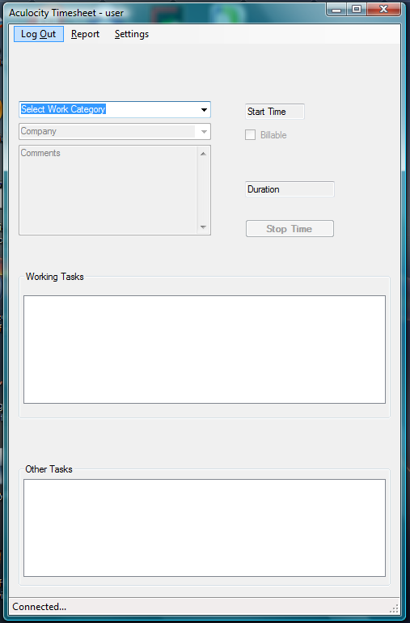
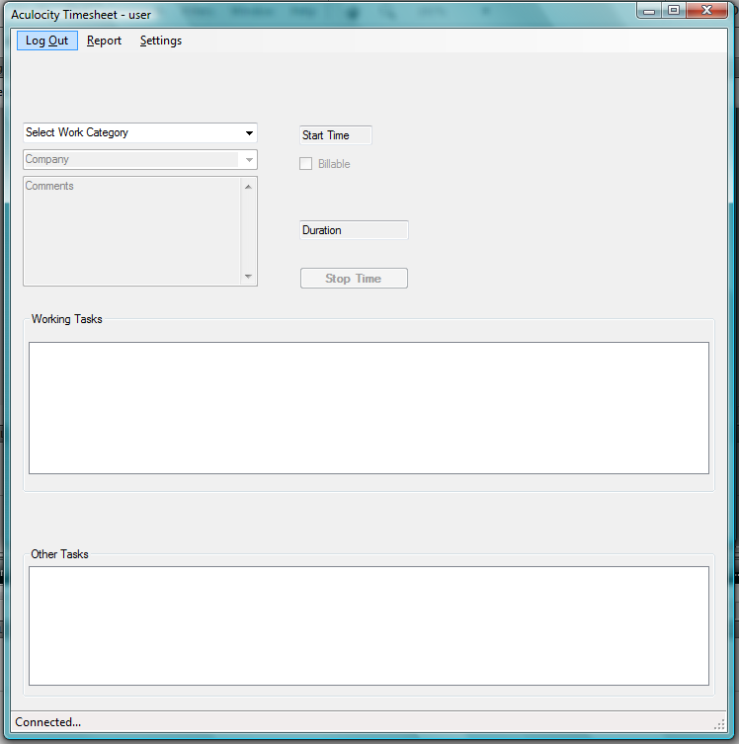
Screen 01 – main window
On user login this screen is loaded
Which can be resized

Slide 3
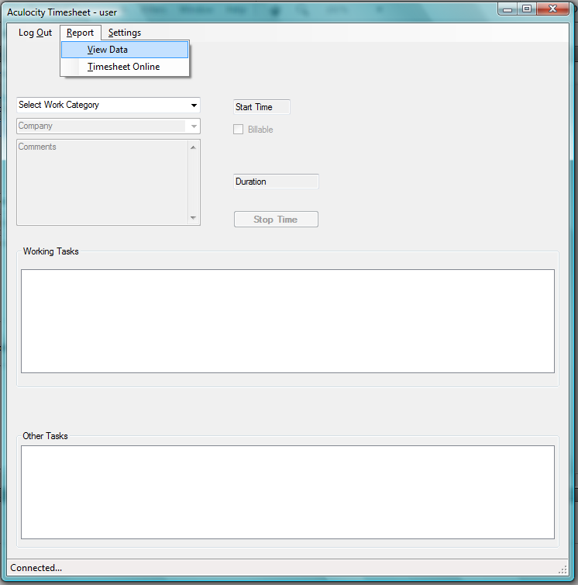
Screen 01
Different options can be choose from the menu:
Log Out
Report
View Data ( open user data to be uploaded or exported to a csv file)
Timesheet Online (open the online timesheet website)
Settings

Slide 4
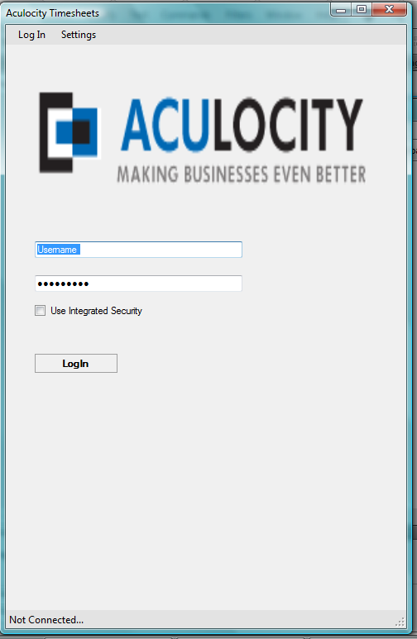
Screen 02 - LogIn
On log out the user sees this screen
User can use integrated security to login
User have full access to settings

Slide 5
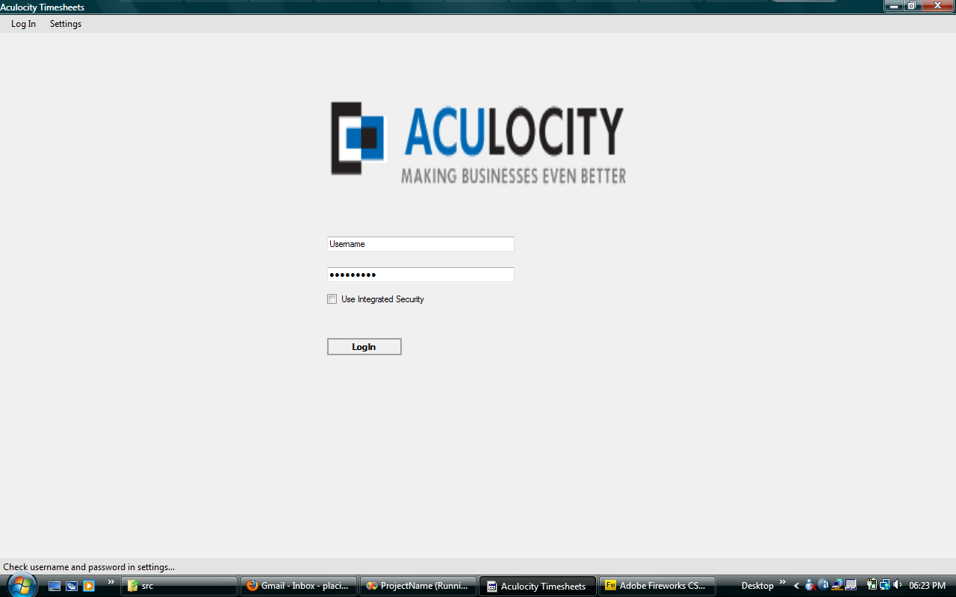
Screen 02 - LogIn

Slide 6
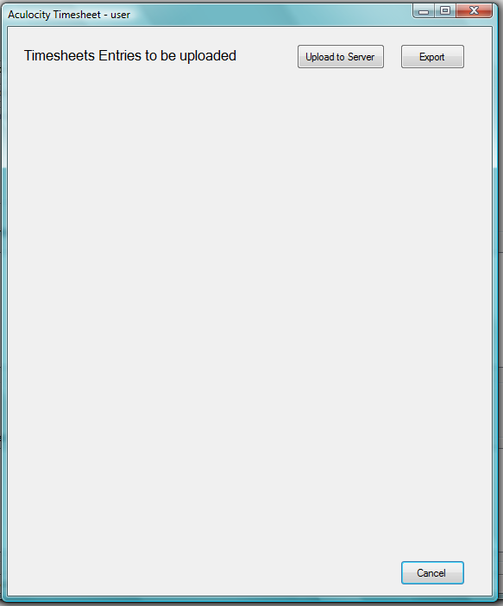
Screen 03 – Report View Data
User can preview data before uploading to tlbTimesheet or export to csv file
Table view will be loaded programmatically

Slide 7
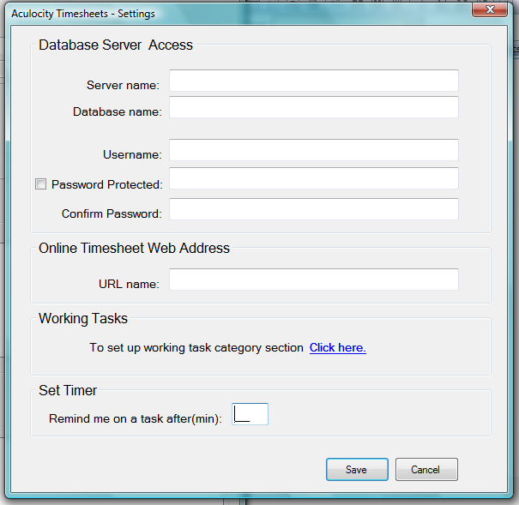
Screen 04 - Settings
User can :
set up database connectivity requirements
Select which work category should appear in the working task section
Set online web address
Set a timer to remind him/her while busy with a task

Slide 8
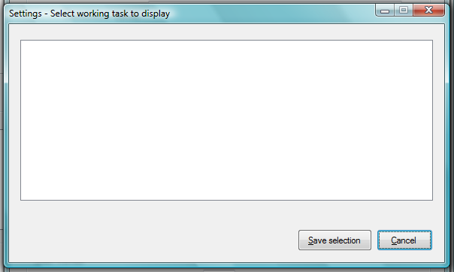
Screen 04 – Settings Set working task list
A checkedlistbox will be used to populate all work category
User selects task to work on and save the selection

